Slide 1
Wine Quality 🍷
Lora Milam, Sally comer, and payal pawar
CS 4331 003: Information Retrieval
Final Presentation

Slide 2
Table of contents
Abstract
Dataset
Experimental Results
Correlation
Prediction
Method and Proposed Model
K-means and Hierarchical Clustering Comparison
Contributions
Acknowledgments

Slide 3
Abstract
Producing high quality wine is desirable for wineries. Unfortunately, wine quality can only be known after wine has been made and aged. To predict quality, this poster proposed a K-means clustering approach versus the hierarchical clustering approach. K-means algorithm is an iterative algorithm that tries to partition the dataset into K pre-defined distinct non-overlapping clusters. Similarly, Hierarchical clustering is a method of clustering analysis that tries to partition the dataset into clusters. However, hierarchical clustering also tries to build a hierarchy out of the clusters made. The proposed methods use variables such as sulphates, volatile acidity, and residual sugar to predict wine quality.

Slide 4
DataSet
Dataset: Wine Quality provided by Jason Brownlee on November 25, 2016 in Machine Learning Process
Observations: 4,989
Predictor Variables: 11
Fixed acidity, Volatile acidity, Citric acid, Residual sugar, Chlorides, Free sulfur dioxide, Total sulfur dioxide, Density, pH, Sulphated, Alcohol
Target Variables: 1
Quality
Subsets: Test(25%), Training(75%)

Slide 5
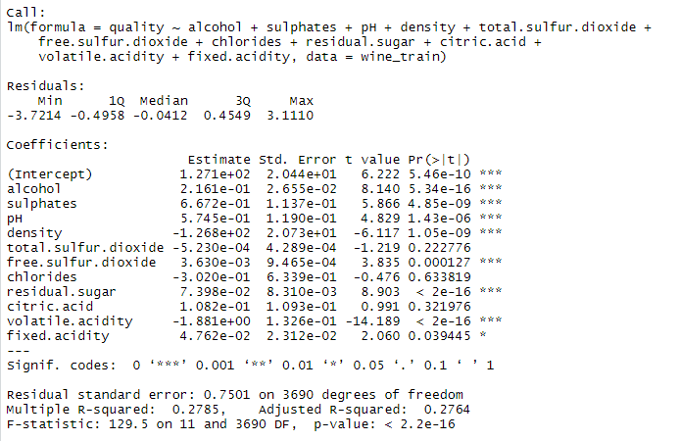
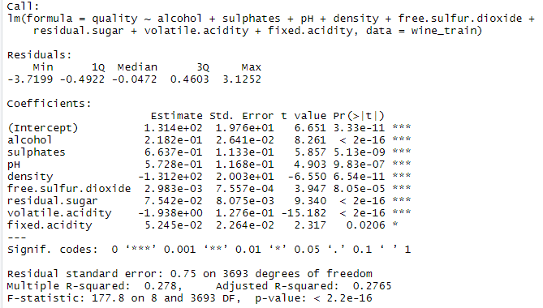
Experimental Results Correlation variables with wine quality
Due to high P-values, Chlorides, Total.Sulfur.Dioxide, and Citric Acid will be deducted from the Predictor variables
Remaining predictive variables are Alcohol, Sulphates, pH, Density, Free.Sulfer.Dioxide, Residual.Sugars, Volatile.acidity, and Fixed.Acidity
<- Non-Processed
Processed ->

Slide 6
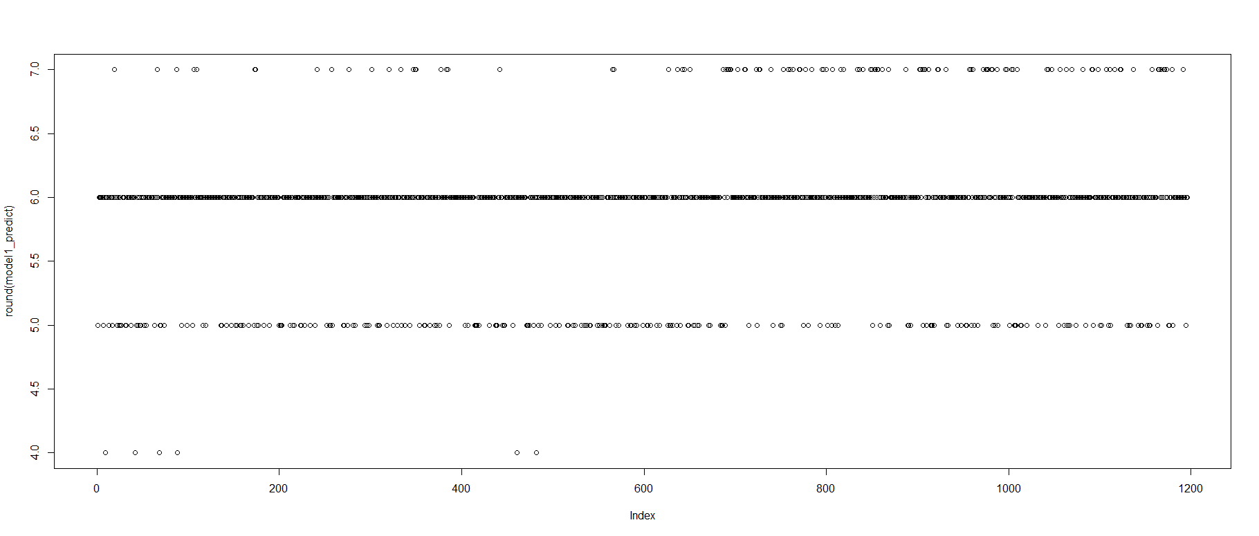
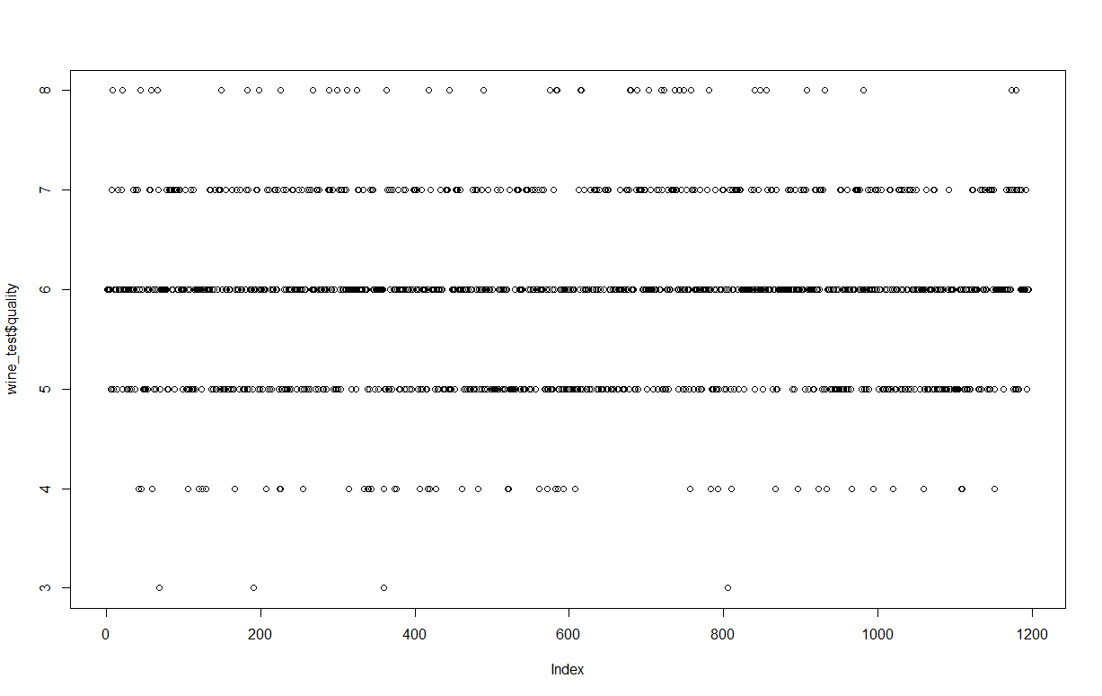
Experimental Results Predictive Experimental Results
Predictive Results ->
<-Actual Results

Slide 7
Method and Preposed Model K-means and Hierarchical Clustering Comparison
Proposed models:
K-means
Hierarchical Clustering
The number of clusters, also referred to as factors, will be 1, 2 ,5, and 10
Hierarchical Clustering will be set to “Ward.D” for all Hierarchical Clustering visualization

Slide 8
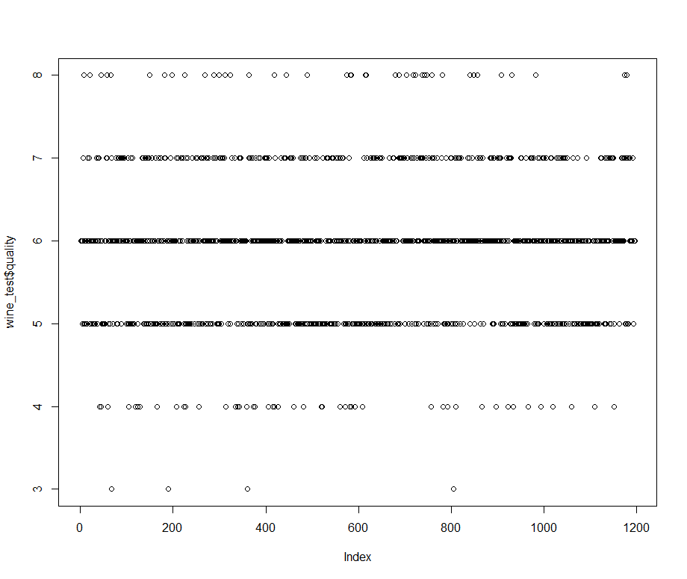
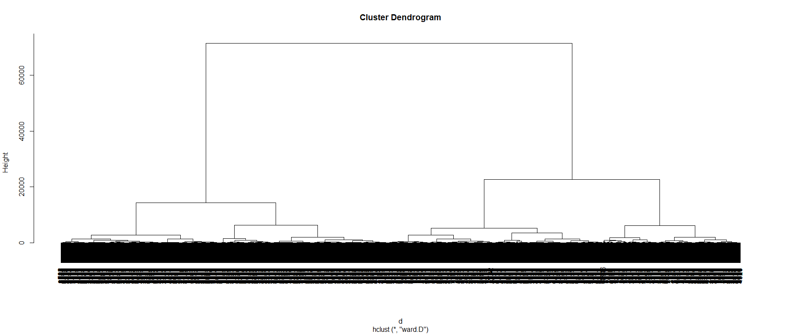
Method and Preposed Model K-means and Hierarchical Clustering Comparison: Factor of 1
K-means
Hierarchical Clustering

Slide 9
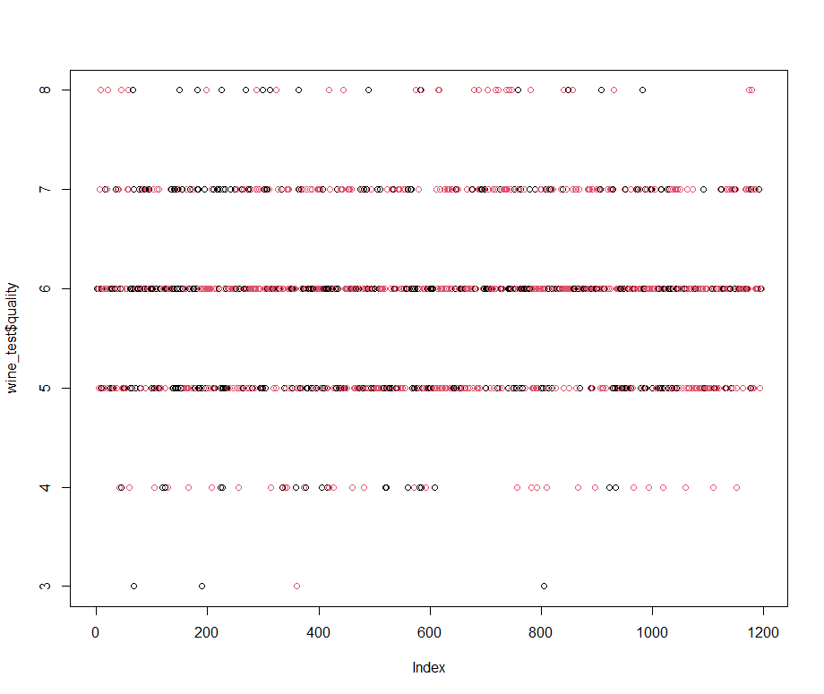
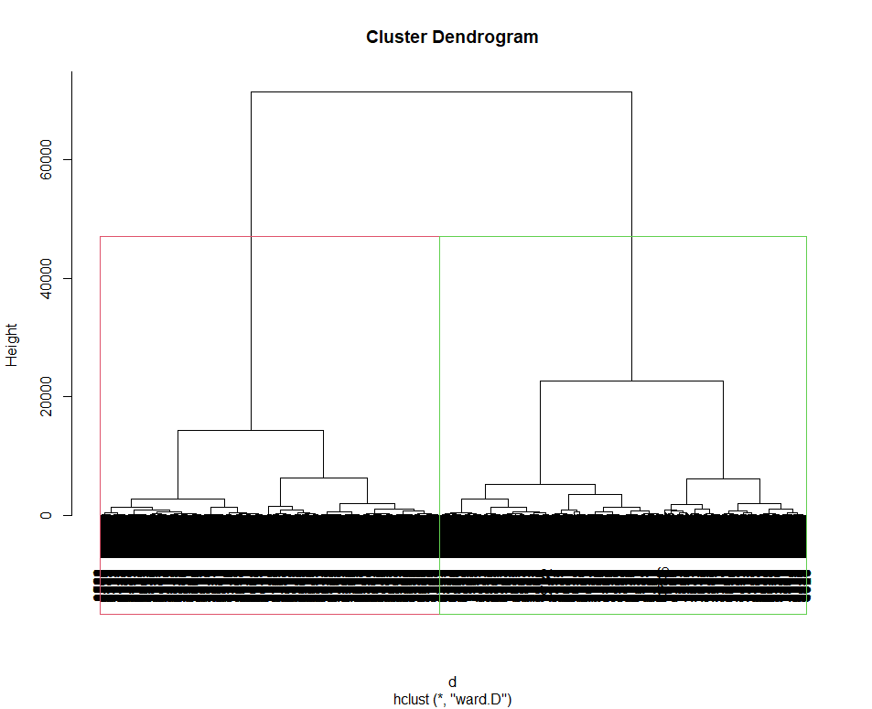
Method and Preposed Model K-means and Hierarchical Clustering Comparison: Factor of 2
K-means
Hierarchical Clustering

Slide 10
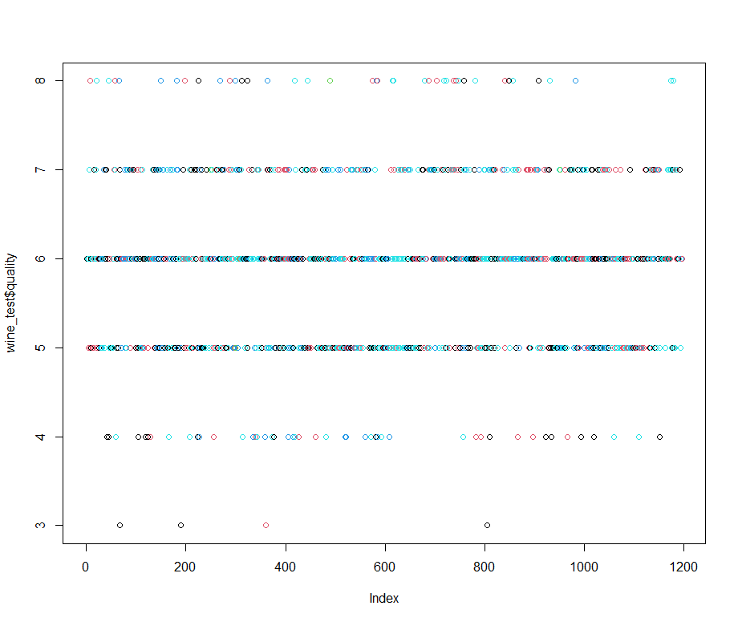
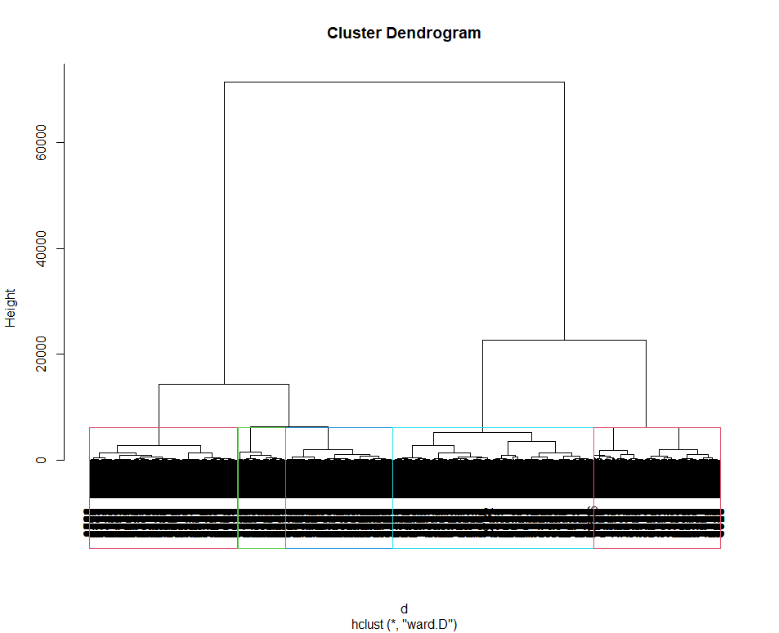
Method and Preposed Model K-means and Hierarchical Clustering Comparison: Factor of 5
K-means
Hierarchical Clustering

Slide 11
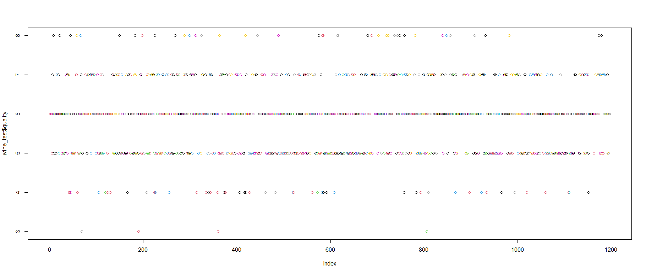
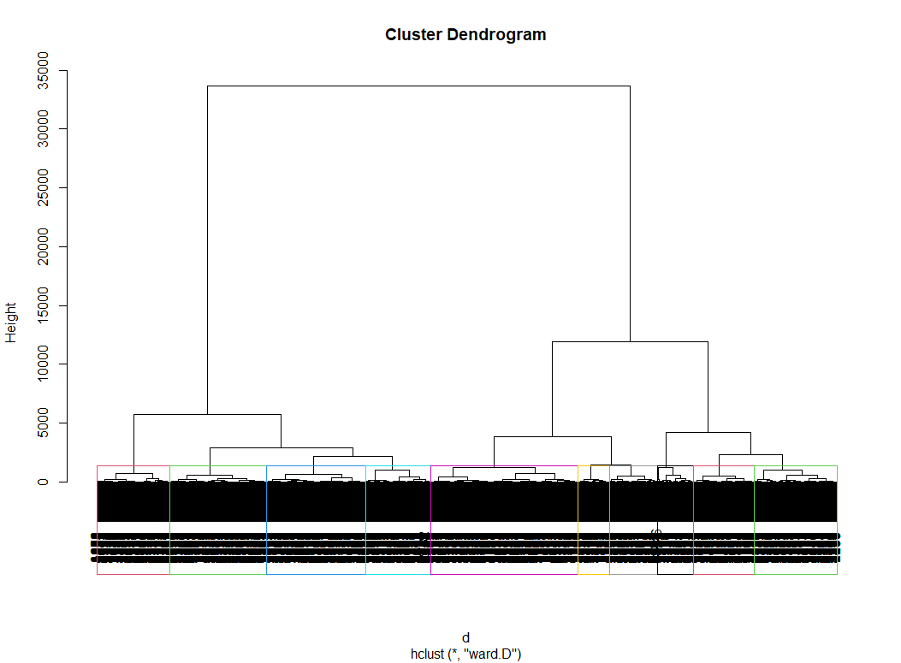
Method and Preposed Model K-means and Hierarchical Clustering Comparison: Factor of 10
K-means
Hierarchical Clustering

Slide 12
Contributions
To review, the modeling methods proposed for this data set were:
K-means:
Assessment: It was hard to see the differences in plots and induvial clusters due to the randomization and the closeness of the individual points
Hierarchical Clustering:
Assessment: Had a better visualization for the separation of individual clusters
Overall, the model chosen to best represent this data set was the hierarchical clustering

Slide 13
Acknowledgements
This data set was provided by P. Cortez, A. Cerdeira, F. Almeida, T. Matos and J. Reis.
Modeling wine preferences by data mining from physicochemical properties. We thank the authors for their detailed dataset.
https://machinelearningmastery.com/standard-machine-learning-datasets/

Slide 14
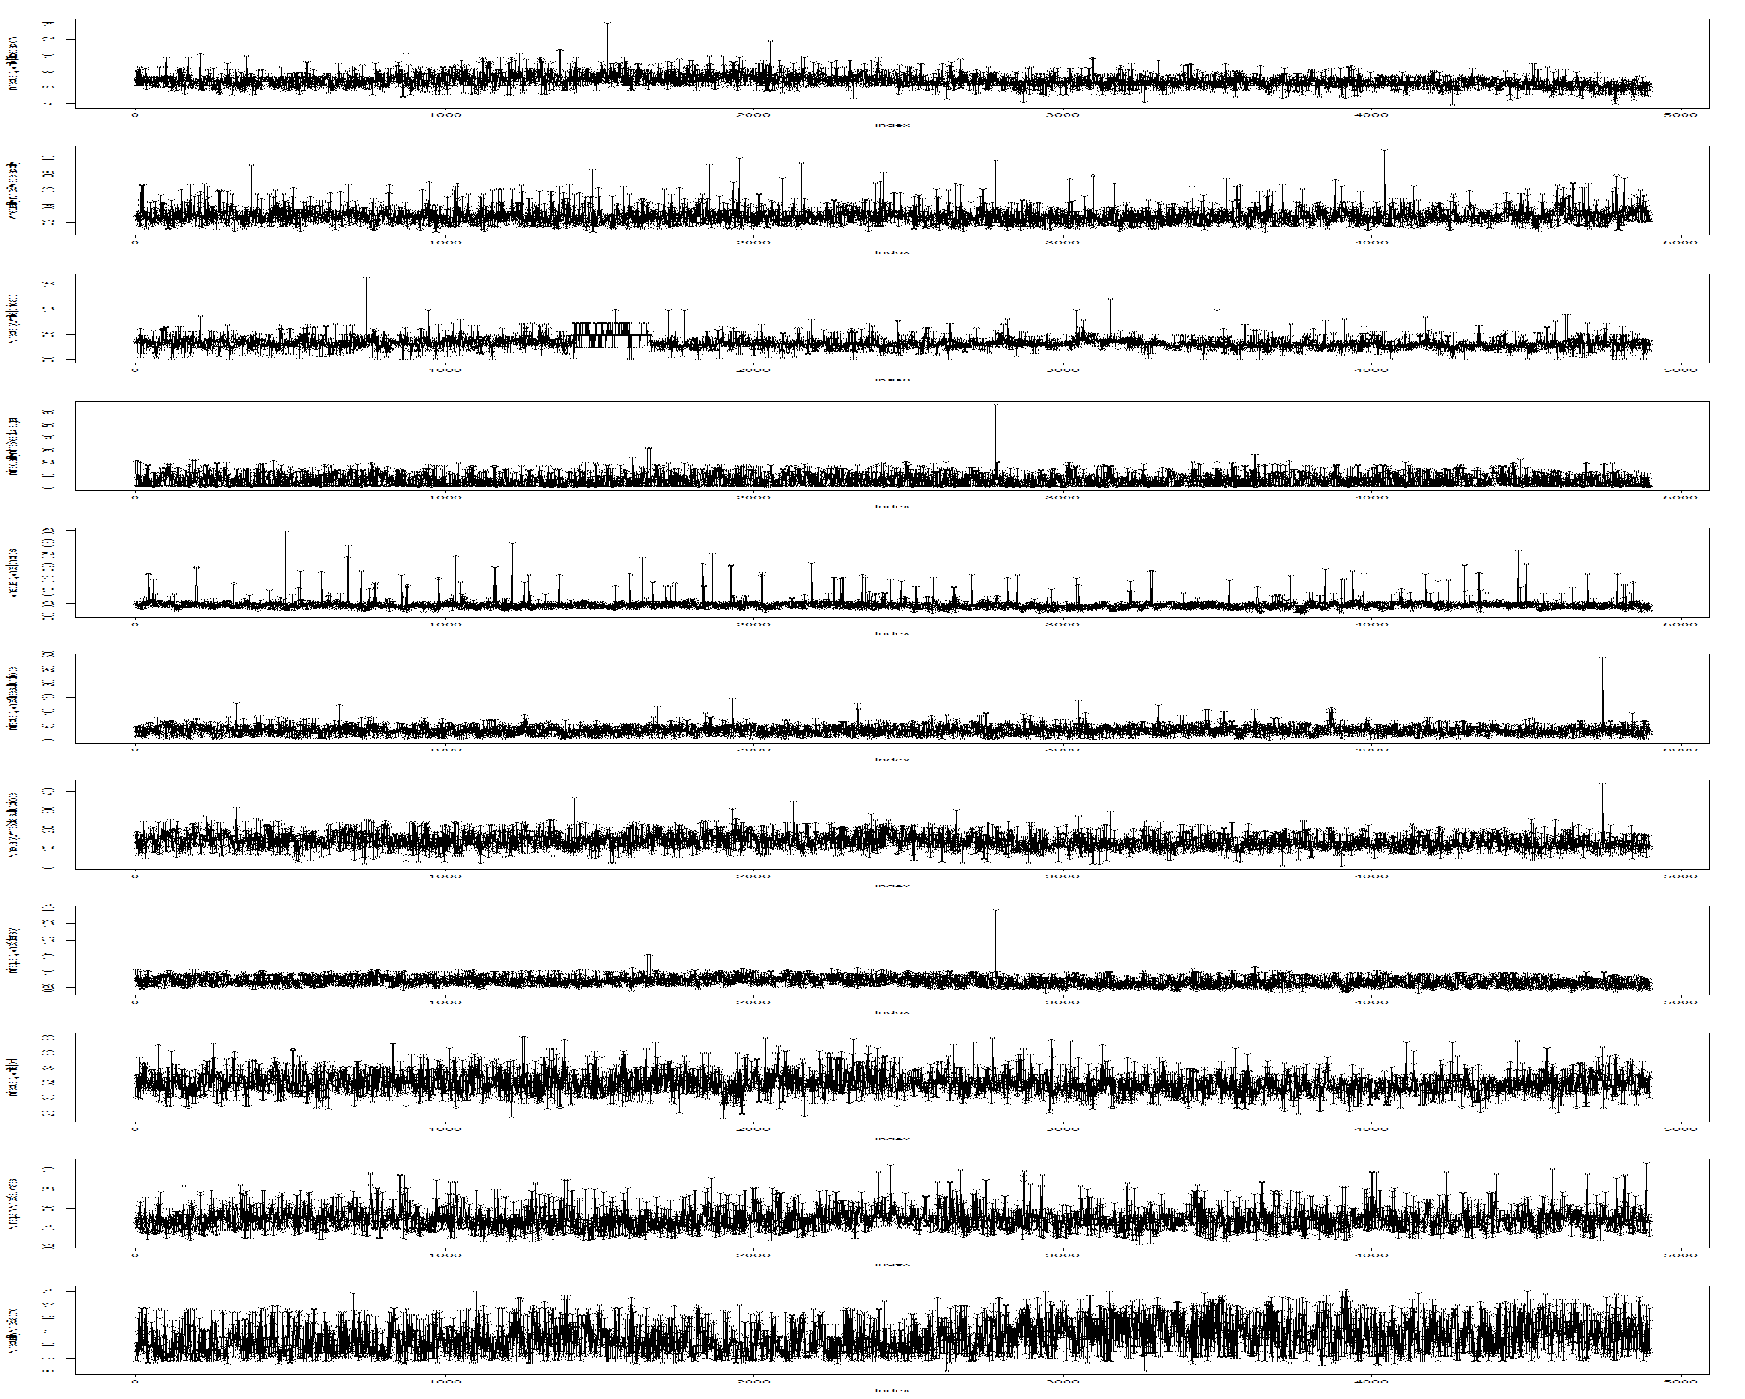
Wine Quality 🍷
Lora Milam, Sally Comer, and Payal Pawar
Computer Science Department, Texas Tech University
Abstract
Producing high quality wine is desirable for wineries. Unfortunately, wine quality can only be known after wine has been made and aged. To predict quality, this poster proposed a K-means clustering approach versus the hierarchical clustering approach. K-means algorithm is an iterative algorithm that tries to partition the dataset into K pre-defined distinct non-overlapping clusters. Similarly, Hierarchical clustering is a method of clustering analysis that tries to partition the dataset into clusters. However, hierarchical clustering also tries to build a hierarchy out of the clusters made. The proposed methods use variables such as sulphates, volatile acidity, and residual sugar to predict wine quality.
Method and Proposed Model Comparison
Hierarchical Clustering
Wine Dataset
Factor of: 1 2 5 10
Predictor Variables Plotted
K-Means Clustering Performance
Factor of: 1 2 5 10
Experimental Results
Contribution
For this dataset, modeling methods used were k-means clustering and hierarchical clustering. The modeling type that best represented this data set, however, was Hierarchical clustering. K Means clustering starts with random choice of clusters, the results produced by running the algorithm multiple times might differ in clusters in other scenarios but showed very little difference in this one. While results are reproducible in Hierarchical clustering and have a more visible view of differences in clusters. So since hierarchical clustering provides constant results, there was a visualization for the data set rather than the visualization provided by K-means clustering.
Correlation of Variables with Wine Quality
Predictive Experimental Results
Acknowledgment
This data set was provided by P. Cortez, A. Cerdeira, F. Almeida, T. Matos and J. Reis. Modeling wine preferences by data mining from physicochemical properties. We thank the authors for their detailed dataset.
Original Processed Top: Predicted; Bottom: Actual

Slide 15
Questions?

